Slide 1
PERC
Tony Mason
Introduction
Persistence Efficient Recoverable Consistent Conclusions
PERC: Persistent, Efficient, Recoverable, Consistent
William Anthony Mason
¹Department of Computer Science The University of British Columbia
December 14, 2018
Notes:
This presentation is based upon work that I conducted beginning in Spring 2018.

Slide 2



PERC
Tony Mason
1
Introduction
Introduction
Persistence Efficient Recoverable Consistent Conclusions
2
Persistence
3
Efficient
4
Recoverable
5
Consistent
6
Conclusions
Notes:
When considering NVRAM, there are four competing areas in competition; there is no one “right” balance between these and instead it must depen upon the usage of the NVRAM.

Slide 3




Outline
PERC
Tony Mason
1
Introduction
Introduction
Persistence Efficient Recoverable Consistent Conclusions
2
Persistence
3
Efficient
4
Recoverable
5
Consistent
6
Conclusions

Slide 4

Memory
PERC
Tony Mason
Introduction Persistence Efficient Recoverable Consistent Conclusions
Without memory, there is no culture. Without memory, there would be no civilization, no society, no future.
— Elie Wiesel
Notes:
While originally computer memory was non-volatile the introduction of DRAM changed our usage model to considering it volatile. Thus the original model of memory and disk being part of a continuum (like an infinite tape) gave way to a clear distinction between memory and storage. The return to persistent memory changes this. Thus, the choice of this epigraph.

Slide 5
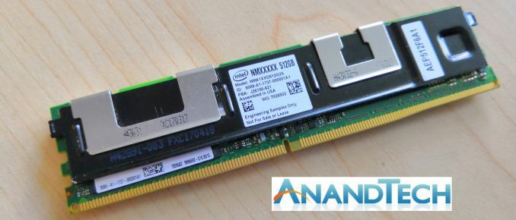
Non-Volatile RAM
PERC
Tony Mason
Introduction Persistence Efficient Recoverable Consistent Conclusions
Notes:
NVRAM, such as Intel’s forthcoming Optane product, is a byte-addressable persistent memory product. It will come in a standard DDR-4 (or DDR-5) DIMM package – computer memory as we’ve been using it for 20+ years.
Is this memory? Is this storage? Part of this exploration was intended to help answer this question.

Slide 6
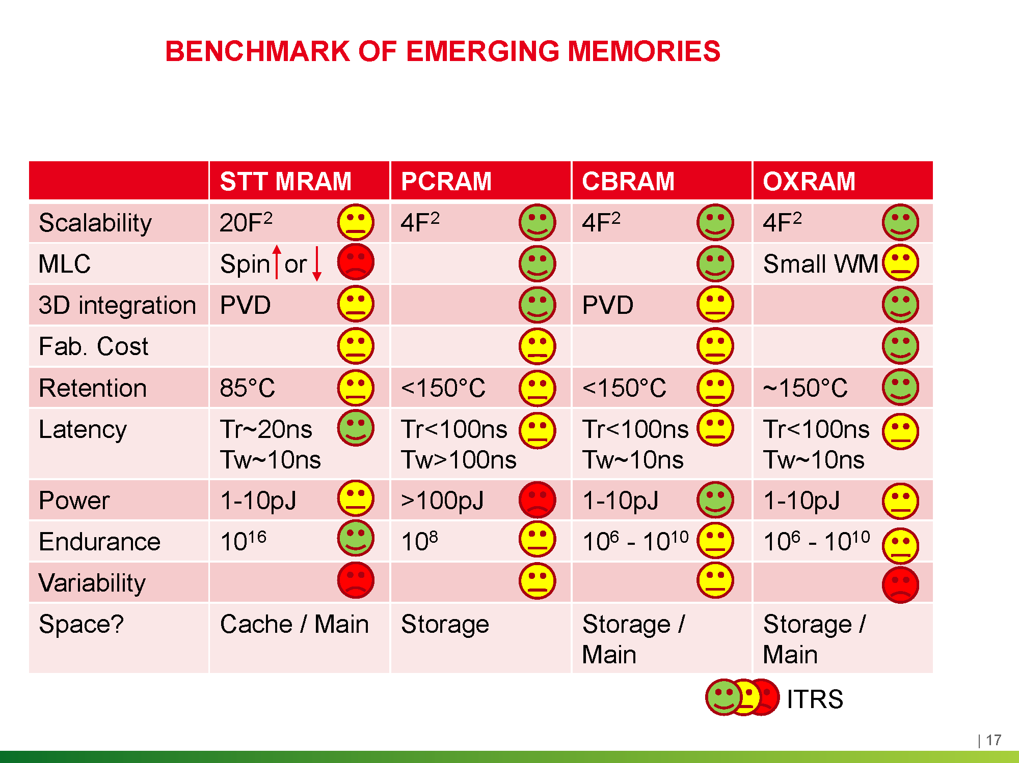
NVRAM Technologies
PERC
Tony Mason
Introduction Persistence Efficient Recoverable Consistent Conclusions
Source: Breaking the Memory Bottleneck in Computing Applications with Emerging Memory Technologies: a Design and Technology Perspective
Notes:
In fact, Optane Memory (PCM) is the first of multiple forthcoming memory technologies. The characteristics of these memory types differ and I have tried to focus on more general reasoning than specific performance to glean insights.

Slide 7

Outline
PERC
Tony Mason
1
Introduction
Introduction
Persistence Efficient Recoverable Consistent Conclusions
2
Persistence
3
Efficient
4
Recoverable
5
Consistent
6
Conclusions
Notes:
Persistence in this case means “the data remains in the absence of power”. Note that it may not remain indefinitely (previous figure). How does that differ from existing memory.
(if time, explain how my emulated NVM remained valid across reboots.)

Slide 8

Persistence
PERC
Tony Mason
Introduction Persistence Efficient Recoverable Consistent Conclusions
Notes:
A considerable amount of persistence has been required for this project!
Just not the kind of persistence I mean.

Slide 9
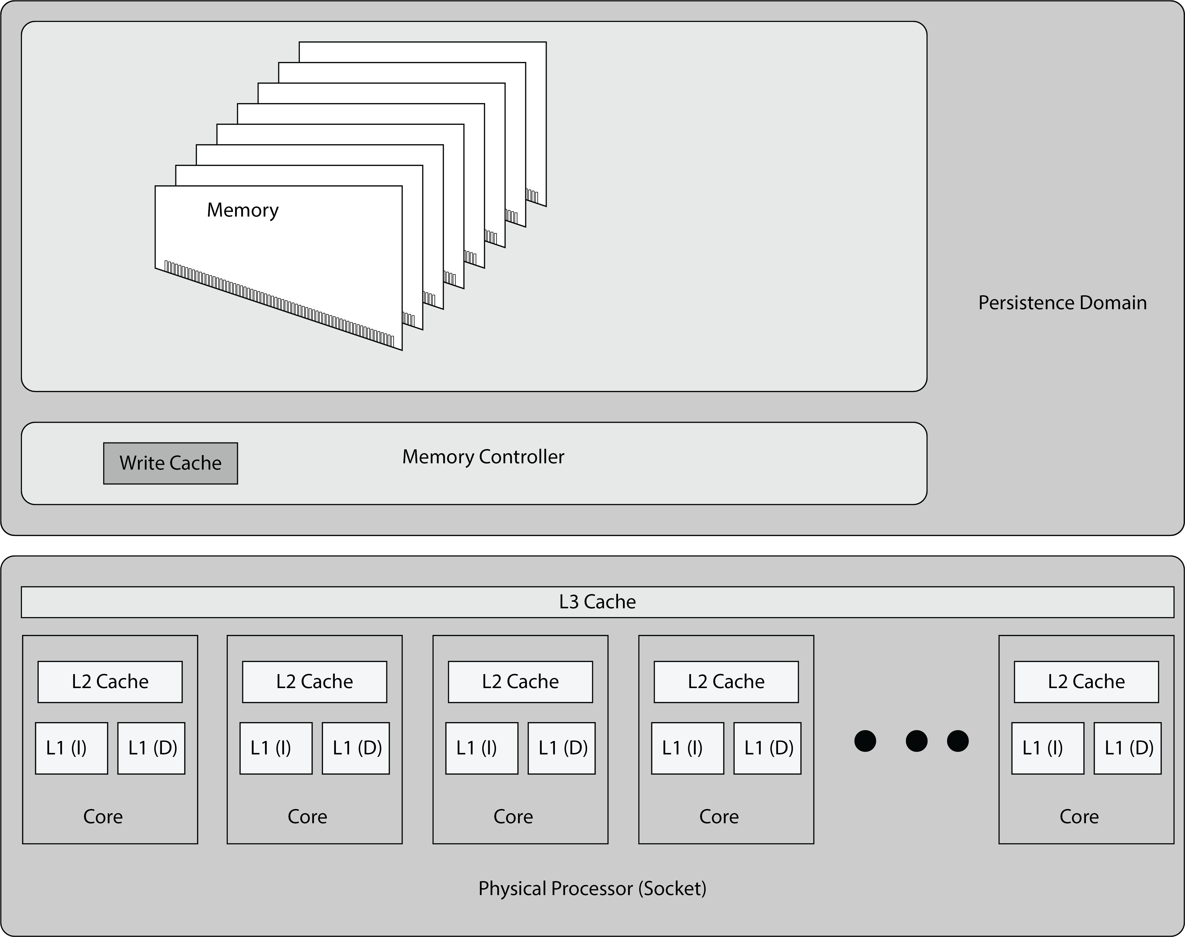
Persistence
PERC
Tony Mason
Introduction Persistence Efficient Recoverable Consistent Conclusions
Notes:
A key understanding for NVM is the persistence domain. This ties into one of the important considerations for NVRAM – we now have to reason about processor behaviour.
Describe caches (L1D – mutable, L1/L2/L3/L4 immutable). Memory Controller Write Back cache (64 bytes x 56 on my machine).

Slide 10
Outline
PERC
Tony Mason
1
Introduction
Introduction
Persistence Efficient Recoverable Consistent Conclusions
2
Persistence
3
Efficient
4
Recoverable
5
Consistent
6
Conclusions
Notes:
We want our systems to be fast. But how do we achieve this? What are the performance characteristics of this memory? Are we concerned with speed, capacity, durability?
Warning: this reasoning will change more as we use different memories.

Slide 11
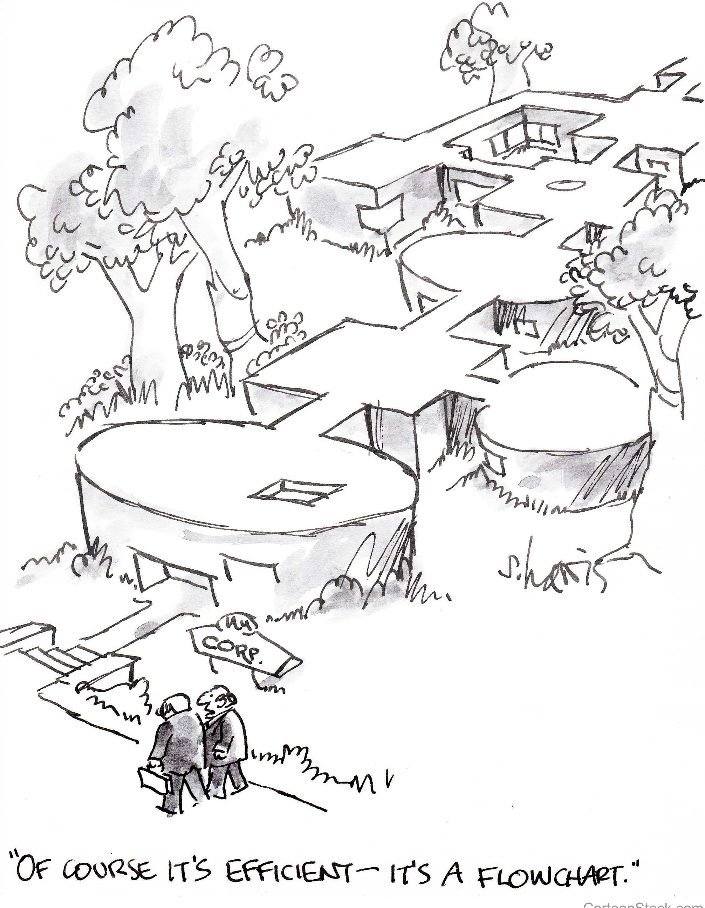
Efficient
PERC
Tony Mason
Introduction Persistence Efficient Recoverable Consistent Conclusions
Notes:
One key to efficiency: understanding the problem you are trying to solve.

Slide 12
Efficient
PERC
Tony Mason
Sequential Copy Multi‐NVM Single‐DRAM
6E+09
5E+09
4E+09
3E+09
2E+09
1E+09
0
1 2 3 4 5 6 7 8 9 10 11 12 13 14 15 16 17 18 19 20
Core Count
NVM Ticks (Average) DRAM Ticks (Single Core)
Sequential Copy Single‐NVM Multi‐DRAM
2.4E+09
2.2E+09
2E+09
1.8E+09
1.6E+09
1.4E+09
1.2E+09
1E+09
800000000
1 2 3 4 5 6 7 8 9 10 11 12 13 14 15 16 17 18 19 20
Core Count
NVM Ticks (Single Core) DRAM Ticks (Average)
Introduction
Persistence Efficient Recoverable Consistent Conclusions
Click Ticks
Click Ticks
Sequential Copy Multi‐eNVM Single‐DRAM
Sequential Copy Single‐eNVM Multi‐DRAM
5E+09
4E+09
3E+09
2E+09
1E+09
0
3E+09
2.5E+09
2E+09
1.5E+09
1E+09
500000000
0
CPU Ticks
CPU Ticks
1 2 3 4 5 6 7 8 9 10 11 12 13 14 15 16 17 18 19 20
eNVM Cores
eNVM Ticks/core DRAM Ticks
1 2 3 4 5 6 7 8 9 10 11 12 13 14 15 16 17 18 19 20
DRAM Cores
eNVM Ticks DRAM Ticks/core
Notes:
Question: does a slow resource (NVM) create a performance bottleneck for the fast resource (DRAM)?
A: No. The hardware appears to separate them.
Todo: Look at mixed workloads (data collected, awaiting analysis).
Note: eNVM (from the Intel PMDK – define it) does not behave like NVM or DRAM. Prior work is suspect.

Slide 13
Outline
PERC
Tony Mason
1
Introduction
Introduction
Persistence Efficient Recoverable Consistent Conclusions
2
Persistence
3
Efficient
4
Recoverable
5
Consistent
6
Conclusions
Notes:
Recoverable: this is about being able to restart the system and resume operation. The issues here are between the “window of vulnerability” and the cost associated with that – distributed systems writ large.

Slide 14
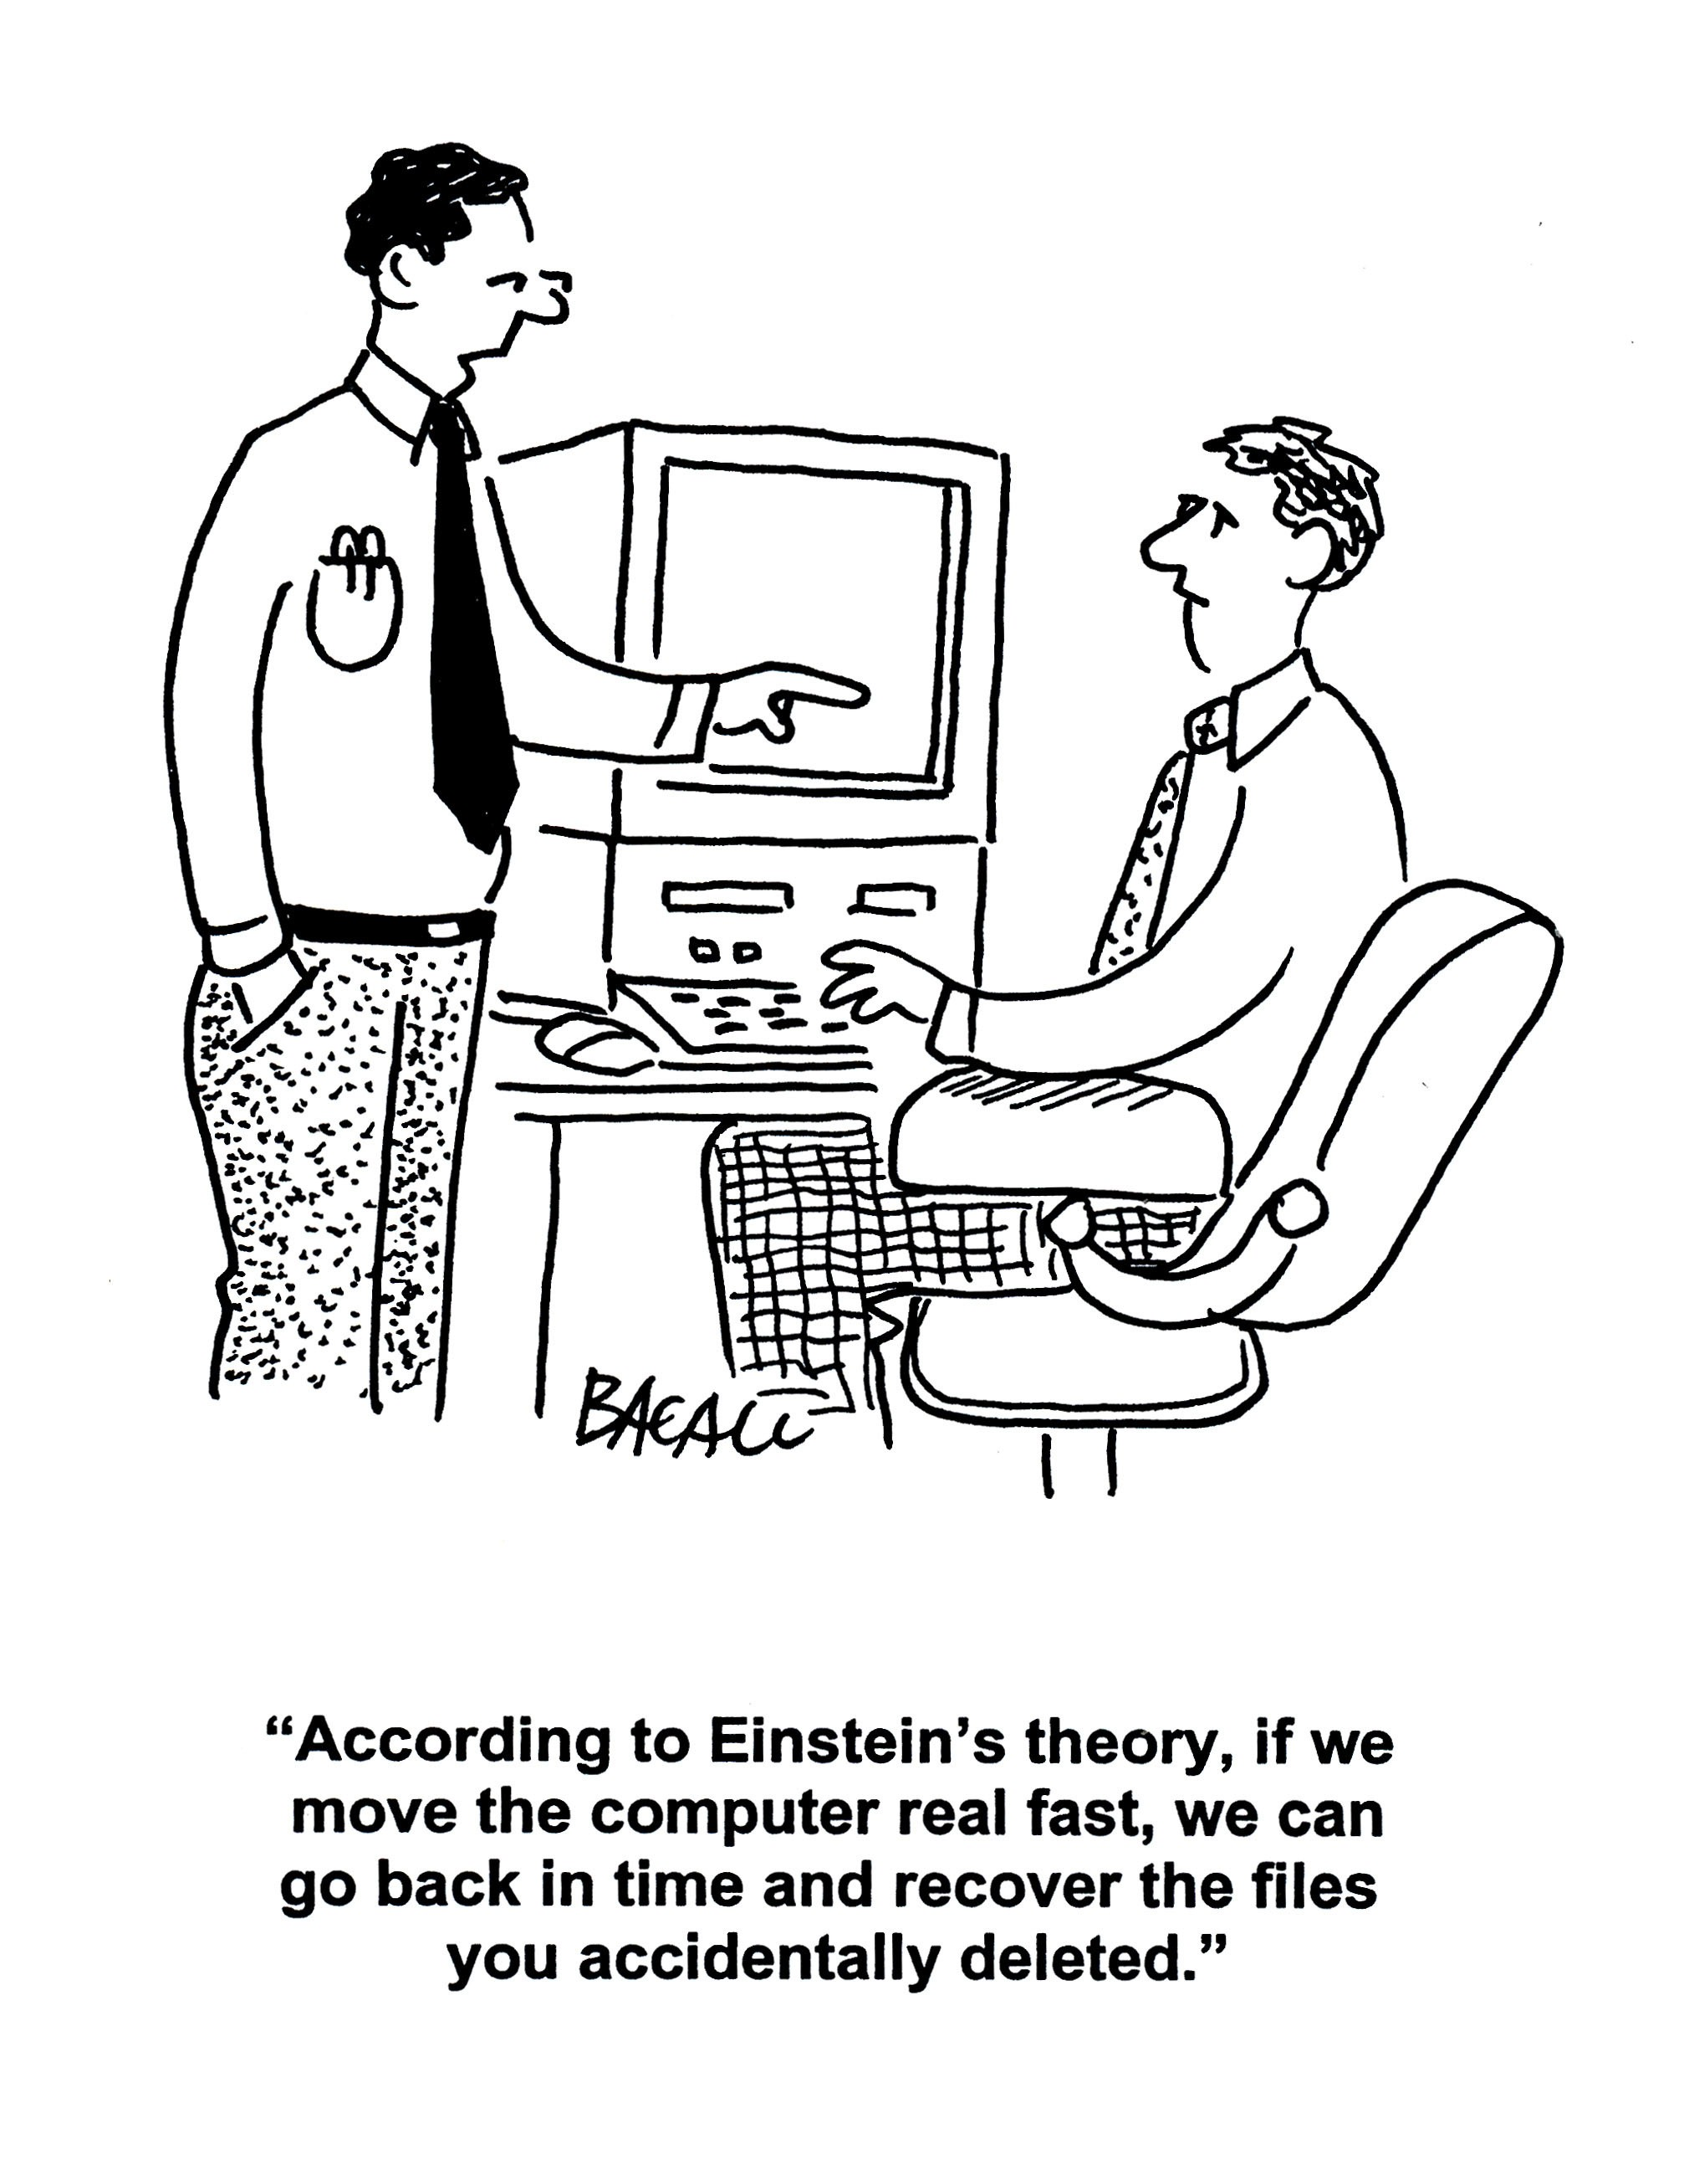
Recoverable
PERC
Tony Mason
Introduction Persistence Efficient Recoverable Consistent Conclusions
Notes:
Open Issue: how to deal with NVM that “moves” addresses upon reboot (VA->PA mapping changes). For DRAM we don’t care.
Open Issue: how can our tools and languages deal with mixing pointers across memory domains.

Slide 15
Micro Benchmarks
PERC
noflush, periodic sfence, same cache set
Tony Mason
40
35
30
25
20
15
10
5
0
Introduction
Persistence Efficient Recoverable Consistent Conclusions
CPU Ticks per operation
1
2
3
4 5 6 7 8 16
SFENCE frequency (once per N writes)
4 6 8 12 16 32 64
32
64
128
noflush, periodic sfence, different cache set
40
35
30
25
20
15
10
5
0
CPU Ticks per operation
1
2
3
4 5 6 7 8 16
SFENCE period (once per N writes)
4 6 8 12 16 32 64
32
64
128
Notes:
Balance Recoverability against performance
We consider: (1) cache associativity [explain why]; (2) flushing from the L1 cache (clflush, clflushopt, clwb); and fencing – pushes to the persistence domain

Slide 16
Micro Benchmarks
PERC
Linked List + Write (No Flush)
70
60
50
40
30
20
10
0
4 6 8 12 16 32 64
Page Count (one list entry per page)
Tony Mason
CPU Ticks Per operation
Introduction
Persistence Efficient Recoverable Consistent Conclusions
initialize
walk + prefetch
walk + sfence each run
walk
walk + sfence each write
Linked List + Write (Including Flush)
CPU Ticks Per operation
6000
4000
2000
0
4 6
8 12 16
Page Count (one list entry per page)
32
64
initialize
walk + prefetch
walk + prefetch + clflush
walk
walk + clflush
walk + sfence each write
walk + sfence each run

Slide 17
Micro Benchmarks
PERC
Tony Mason
Introduction
Persistence Efficient Recoverable Consistent Conclusions
clwb, periodic fence, same cache sets
40
35
30
25
20
CPU Ticks per operation
15
10
5
0
1
2
3
4 5 6 7 8 16
SFENCE period (once per N writes)
4 6 8 12 16 32 64
32
64
128
Notes:
This is a representative trace (not updated). In it, I look at the impact of a strategy of aggressive flushing and increasingly passive fencing.
Flushing – fills the pipeline. Writes can be combined in the MC. Clwb = “flush but don’t invalidate”
Fencing – stalls until the previous operations. Atomics, fences, XEND are all data fences.

Slide 18
Micro Benchmarks
PERC
Tony Mason
Introduction
Persistence Efficient Recoverable Consistent Conclusions
clwb, periodic fence, same cache sets
40
35
30
25
20
CPU Ticks per operation
15
10
5
0
1
2
3
4 5 6 7 8 16
SFENCE period (once per N writes)
4 6 8 12 16 32 64
32
64
128

Slide 19
Micro Benchmarks
PERC
clflush, periodic sfence, different cache set
Tony Mason
45
40
35
30
25
20
15
10
5
0
CPU Ticks per operation
Introduction
Persistence Efficient Recoverable Consistent Conclusions
1
2
3
4 5 6 7 8 16
SFENCE period (once per N writes)
6 8 12 16 32
32 64 128
4
64
clflush, periodic sfence, same cache set
120
100
80
60
40
20
0
CPU Ticks per operation
1
2
3
4 5 6 7 8 16
SFENCE period (once per N writes)
4 6 8 12 16 32 64
32 64 128

Slide 20
Micro Benchmarks
PERC
Tony Mason
NVM Flush/Fence Behavior
18
17
Introduction
Persistence Efficient Recoverable Consistent Conclusions
CPU Ticks/operation
16
15
14
13
12
6
8
12
16
32
64
noflush, nofence, same cache set noflush, nofence different cache set noflush, sfence end, same cache set noflush, sfence end, different cache set
clflush, nofence, same cache set clfush, nofence, different cache set clflush, sfence end, same cache set clflush, sfence end, different cache set
Number of Pages
clflushopt, nofence, same cache set clflushopt, nofence, different cache set clflushopt, sfence end, same cache set clflushopt, sfence end, different cache set
clwb, nofence, same cache set clwb, nofence, different cache set clwb, sfence end, same cache set
clwb, sfence end, different cache set
eNVM Flush/Fence Behavior
18
17
CPU Ticks/operation
16
15
14
13
12
6
8
16
Number of Pages
32
64
noflush, nofence, same cache set noflush, nofence different cache set noflush, sfence end, same cache set noflush, sfence end, different cache set
clflush, nofence, same cache set clfush, nofence, different cache set clflush, sfence end, same cache set clflush, sfence end, different cache set
clflushopt, nofence, same cache set clflushopt, nofence, different cache set clflushopt, sfence end, same cache set clflushopt, sfence end, different cache set
clwb, nofence, same cache set clwb, nofence, different cache set clwb, sfence end, same cache set
clwb, sfence end, different cache set
Notes:
Note the impact of cache associativity – fewer stalls.
Note they converge as the working set grows and we fill the memory controller.
Note: aggressive flush does not substantially degrade performance. MC helps soften fence.

Slide 21
Outline
PERC
Tony Mason
1
Introduction
Introduction
Persistence Efficient Recoverable Consistent Conclusions
2
Persistence
3
Efficient
4
Recoverable
5
Consistent
6
Conclusions
Notes:
What does it mean when we say consistent: we don’t lose resource. We don’t roll back unnecessarily. We provide some level of durability guarantees. Turns out this is hard. State space explosion, blah blah blah.
Techniques: transactional memory. Hardware (TSX, atomics, LLSC (load-link/store-conditional), versioning, shadowing, logging, RCU. “Easy to build, hard to get right.”

Slide 22

Consistent
PERC
Tony Mason
Introduction Persistence Efficient Recoverable Consistent Conclusions
Notes:
Classic ACID properties. Often though we are OK with sacrificing strong guarantees for performance – the “common path” versus “uncommon path”.
I do not explore this heavily in this work, but the use of allocators was an initial foray into that area.

Slide 23
Allocation Benchmarks
PERC
Tony Mason
Single DIMM Configuration
Introduction
Persistence Efficient Recoverable Consistent Conclusions
Allocate, Free and Allocate
Allocate, Free and Allocate
5000
Allocate, Free and Allocate
1750
1500
1250
1000
750
500
250
jemalloc (DRAM)
nvm_malloc with CLWB nvm_malloc no fences/flushes pmcto_malloc
pmobj_malloc
1750
1500
1250
1000
750
500
250
jemalloc (DRAM)
nvm_malloc with CLWB nvm_malloc no fences/flushes pmcto_malloc
pmobj_malloc
jemalloc (DRAM)
nvm_malloc with CLWB nvm_malloc no fences/flushes
pmcto_malloc pmobj_malloc
4000
Time in ms
Time in ms
Time in ms
3000
2000
1000
0
2.5 5.0 7.5 10.0 12.5 15.0 17.5 20.0 22.5
0
2.5 5.0 7.5 10.0 12.5 15.0 17.5 20.0 22.5
0
2.5 5.0 7.5 10.0 12.5 15.0 17.5 20.0 22.5
Parallel Threads
Parallel Threads
Parallel Threads
Six-DIMM (striped) configuration
Allocate, Free and Allocate Allocate, Free and Allocate
5000
jemalloc (DRAM) jemalloc (DRAM)
jemalloc (DRAM)
Allocate, Free and Allocate
1200
nvm_malloc with CLWB nvm_malloc with CLWB
⁴⁰⁰⁰⁰ nvm_malloc with CLWB
1000
^{nvm_malloc no fences/flushes} 4000 ^{nvm_malloc no fences/flushes}
nvm_malloc no fences/flushes pmcto_malloc
pmobj_malloc
pmcto_malloc pmobj_malloc
pmcto_malloc pmobj_malloc
30000
Time in ms
800
Time in ms
3000
Time in ms
600
2000
20000
400
1000
10000
200
0
2.5 5.0 7.5 10.0 12.5 15.0 17.5 20.0 22.5
0
2.5 5.0 7.5 10.0 12.5 15.0 17.5 20.0 22.5
0
2.5 5.0 7.5 10.0 12.5 15.0 17.5 20.0 22.5
Parallel Threads
Parallel Threads
Parallel Threads
Notes:
Evaluation: Memory allocators (updated).
Hardware config: 2CPU x 24 core + 384GB RAM + 3TB NVRAM.
NVM config: (updated) 6 x 250GB (separate) + 6 x 250GB (striped)
Test: Allocator benchmark (Hasso-Plattner, similar to Hoarde). Surprise – striping helps. (Misconfig?)

Slide 24
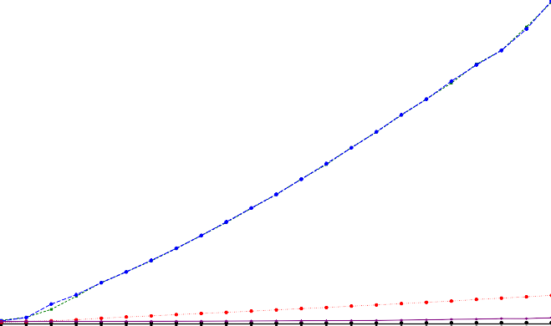
Allocation Benchmarks
PERC
Tony Mason
Introduction Persistence Efficient Recoverable Consistent Conclusions
Allocate, Free and Allocate
40000 | jemalloc (DRAM) nvm_malloc with CLWB
 | nvm_malloc no fences/flushes
30000 | pmcto_malloc pmobj_malloc
20000
10000
0
 | 2.5 | 5.0 7.5 10.0 12.5 Parallel Threads | 15.0 | 17.5 | 20.0 | 22.5
Time in ms
Notes:
This is interesting. Using striping, our allocator scales almost as well as DRAM.
Second observation: jemalloc on NVM (pmcto) is slower than pmobj (which has recoverability guarantees, pmcto does not).
Third observation: HPI allocator doesn’t scale here, but it did before.

Slide 25
Outline
PERC
Tony Mason
1
Introduction
Introduction
Persistence Efficient Recoverable Consistent Conclusions
2
Persistence
3
Efficient
4
Recoverable
5
Consistent
6
Conclusions
Notes:
So… what did I learn? Why have you wasted 20 minutes of your life listening to this?

Slide 26
Lessons
PERC
Tony Mason
Introduction
Persistence Efficient Recoverable Consistent Conclusions
Flush aggressively, fence conservatively

Slide 27
Lessons
PERC
Tony Mason
Introduction
Persistence Efficient Recoverable Consistent Conclusions
Flush aggressively, fence conservatively
flushing fills the pipeline
fencing ensures persistence

Slide 28
Lessons
PERC
Tony Mason
Introduction
Persistence Efficient Recoverable Consistent Conclusions
Flush aggressively, fence conservatively
flushing fills the pipeline
fencing ensures persistence
Write Efficiently

Slide 29
Lessons
PERC
Tony Mason
Introduction
Persistence Efficient Recoverable Consistent Conclusions
Flush aggressively, fence conservatively
flushing fills the pipeline
fencing ensures persistence
Write Efficiently
(Sequential) Read is fast.
Write is slow — beware write amplification
Notes:
This is where I observe something I haven’t shown you here - wait for the paper (Yeah, MICRO)

Slide 30
Lessons
PERC
Tony Mason
Introduction
Persistence Efficient Recoverable Consistent Conclusions
Flush aggressively, fence conservatively
flushing fills the pipeline
fencing ensures persistence
Write Efficiently
(Sequential) Read is fast.
Write is slow — beware write amplification
Optimize NVM/DRAM Usage
Use NVRAM for data that must be persistent Use DRAM for ephemeral operations NVRAM /= DRAM
Notes:
NVRAM and DRAM do best together. NVRAM – higher density. DRAM – faster and ephemeral. Locks in NVRAM may not make any sense. This is likely to shift around as NVRAM matures.
Note that NVRAM is not DRAM – and eNVM wasn’t very close, so much of the prior work isn’t as useful as we’d like. (oh well, 35 years of research down the toilet…)

Slide 31
Questions?
PERC
Tony Mason
Introduction Persistence Efficient Recoverable Consistent Conclusions
Notes:
I’m happy to answer questions.

